Slide 1
Group 14
Sharon NYABUTO
Clare MWANGI
Rita WANGILA
BenARD OTIENO
Grace MUNYI
Michael AKELLO
JOSEPH Amailuk
Jeff OGANGA

Slide 2
TEMBO HOTEL & SUITES
PERFORMANCE REPORT
This report bridges this existing business intelligence gap by processing the data and providing insights regarding room profitability, seasonal trends, staff performance and guest satisfaction to drive high-impact business decisions.

Slide 3
TEMBO HOTEL & SUITES
THE PROBLEM
Tembo Hotel & Suites has been running since 2023 and keeping records in a spreadsheet. The management currently relies on fragmented, error-prone data that limit their ability to make operational and financial decisions.

Slide 4
Dataset description
286 total records: initial raw count from the provided CSV. Data quality issues: over 22 input errors identified. Cleanup required: significant gaps in data, mismatched formatting, and several duplicate entries that need to be removed before analysis.

Slide 5


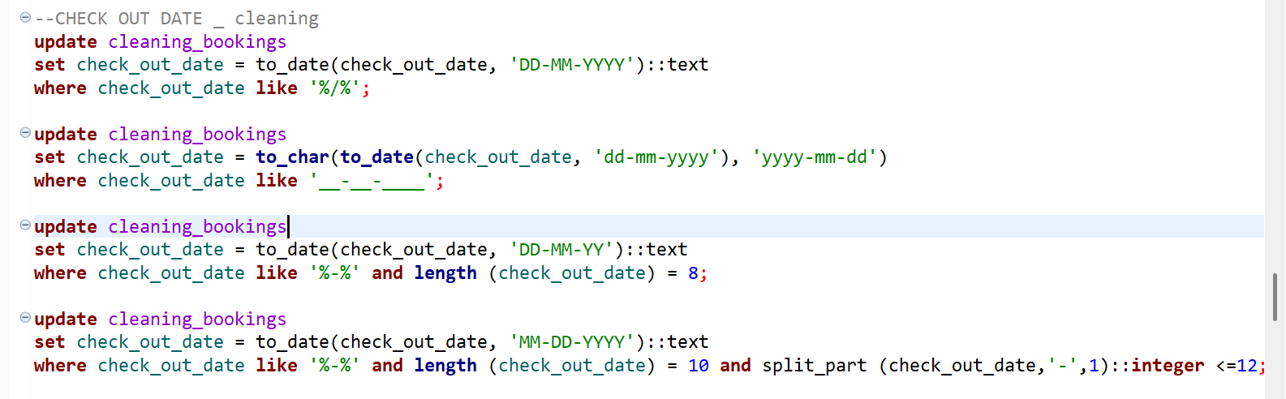
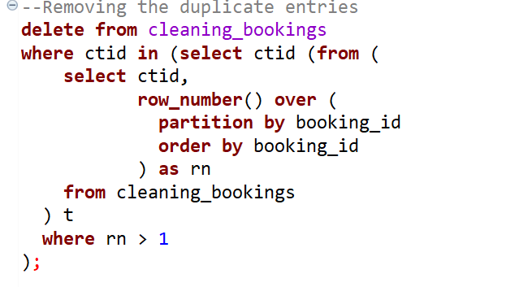
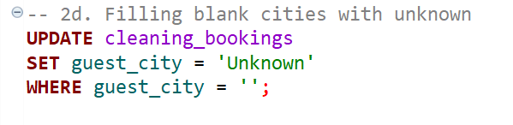
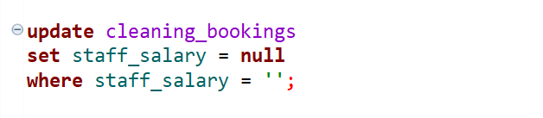
Data cleaning - walk through
3 of the most interesting problems fixed
Standardizing the date formats
Removing duplicate entries
Replacing blank entries with ‘null’ value for numeric data types and ‘unknown’ for string data.

Slide 6
Key findings - Director's questions
Revenue(KES)
8.47 Million
Bookings
285
Average Nights Stayed
3
Cancellation Rate
8.07%
Average Rating
3.04

Slide 7
Key findings - Director's questions
Which rooms make us the most money?
Suites were the top revenue generator at KES 2.42M (28.5% of total). Deluxe rooms follow closely at KES 2.31m (27.3%)
Revenue was relatively well-distributed across all four room types, with the gap between highest and lowest KES 623,500
which months are busiest,
September, November and December are the busiest months, and they are the highest revenue generators. The quietest month is May
Staff Performance
Front desk was the highest earning, generating Kes 2.34 Million in revenue. Kevin Omondi and Brenda Achieng were the staff in this department. Joy Otieno was the best performing staff, generating a total revenue of Kes 1.37Million.
Guest Satisfaction
Feedback shows a moderate happiness level, with guests rating their stay at an average of 3 out of 5. Customer spending remains steady year-round, showing little change between peak and off-peak seasons. Conference rooms were our biggest revenue driver, suggesting high demand and satisfaction with our business services.

Slide 8
Recommendations - based on your data
Based on the analysis, we recommend the following actions:
Increase penthouse marketing highest revenue per booking but lowest volume
Target Q4 weakness - October is the quietest month; introduce promotions.
Implement penthouse deposit policy 20% cancellation rate requires mandatory prepayment
Update the "unknown" city records to better understand geographic spread and enable targeted marketing to expand reach across the country, focusing on underrepresented such as the coastal region.
Recognize top performers, using their workflow as a benchmark for staff training. Gathering his insights will help identify best practices and improve overall team performance.

